Slide 1
The economy as a
Complex system
Pierre-Alexandre Balland
Utrecht University
Toulouse Artificial Intelligence Institute
ESIR Group, European Commission

Slide 2
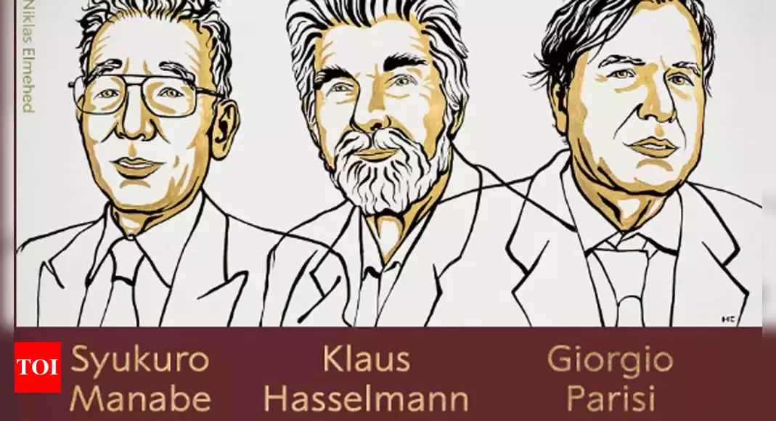
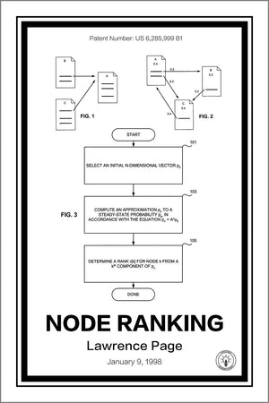



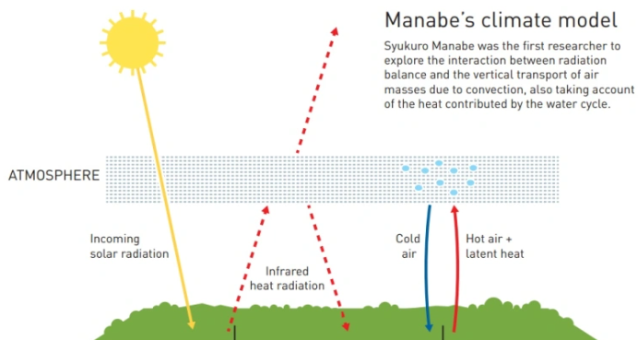
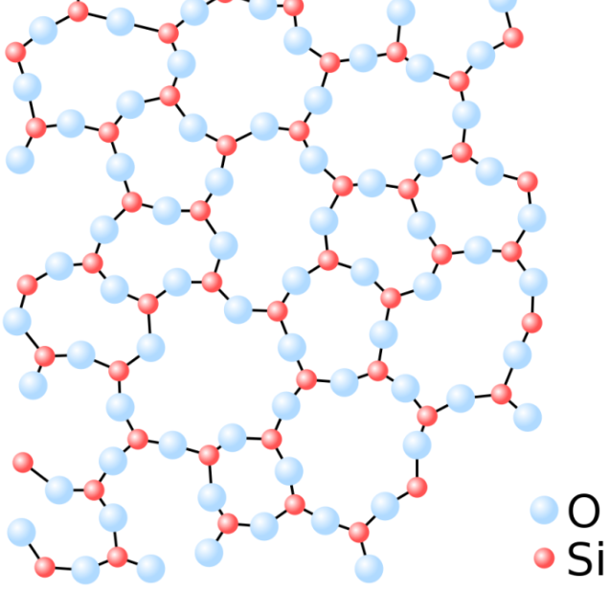


The Century of Complexity
2021’s Physics Nobel Prize is about Complexity Science
AI applications extract information from complex network structures
Notes:
Stephen Hawking (2000): in response to a question about the way that science is developing, replied: “I think the next century will be the century of complexity”

Slide 3
What is Economic Complexity?
Economic complexity is the application of complex systems and network thinking to economics
Notes:
X has produced new metrics that can be used to develop automated recommendation systems
Complexity can be measured in 2 main ways: input-based(NK) or output-based (ECI/TCI)
It is also a large, young, growing community

Slide 4
What is Economic Complexity?
Economic complexity is the application of complex systems and network thinking to economics
Paradigm shift from isolated characteristics to systemic interactions
Notes:
X has produced new metrics that can be used to develop automated recommendation systems
Complexity can be measured in 2 main ways: input-based(NK) or output-based (ECI/TCI)
It is also a large, young, growing community

Slide 5
What is Economic Complexity?
Economic complexity is the application of complex systems and network thinking to economics
Paradigm shift from isolated characteristics to systemic interactions
-> To understand emerging patterns of growth, regional evolution, technological change, inequality, sustainability…
Notes:
X has produced new metrics that can be used to develop automated recommendation systems
Complexity can be measured in 2 main ways: input-based(NK) or output-based (ECI/TCI)
It is also a large, young, growing community

Slide 6
What is Economic Complexity?
Economic complexity is the application of complex systems and network thinking to economics
Paradigm shift from isolated characteristics to systemic interactions
-> To understand emerging patterns of growth, regional evolution, technological change, inequality, sustainability…
Economic complexity produces useful heuristics and metrics to make better business and policy decisions
Notes:
X has produced new metrics that can be used to develop automated recommendation systems
Complexity can be measured in 2 main ways: input-based(NK) or output-based (ECI/TCI)
It is also a large, young, growing community

Slide 7
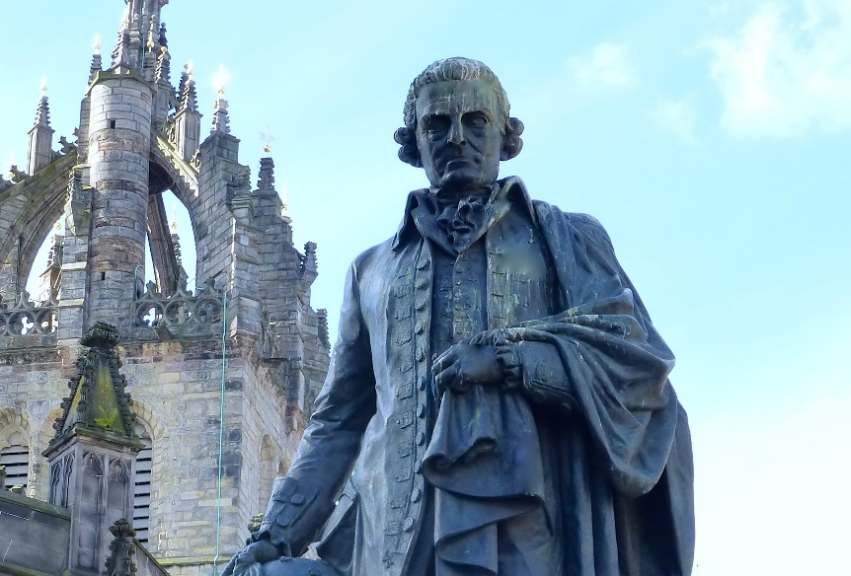
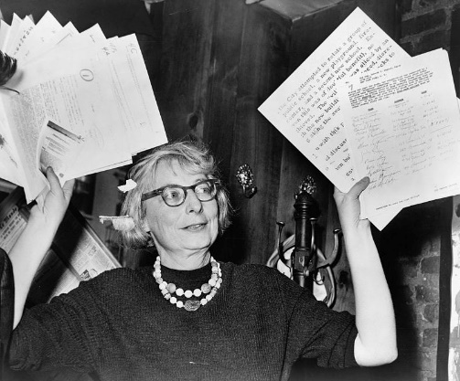
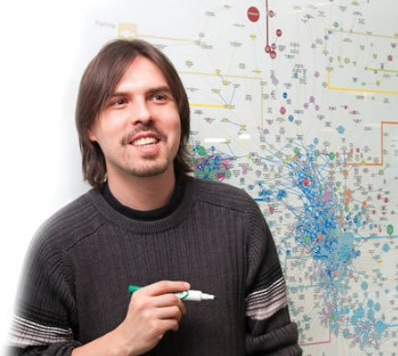

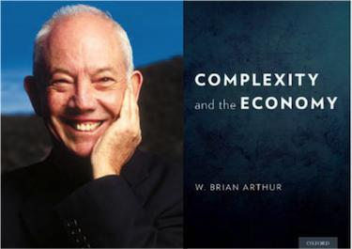
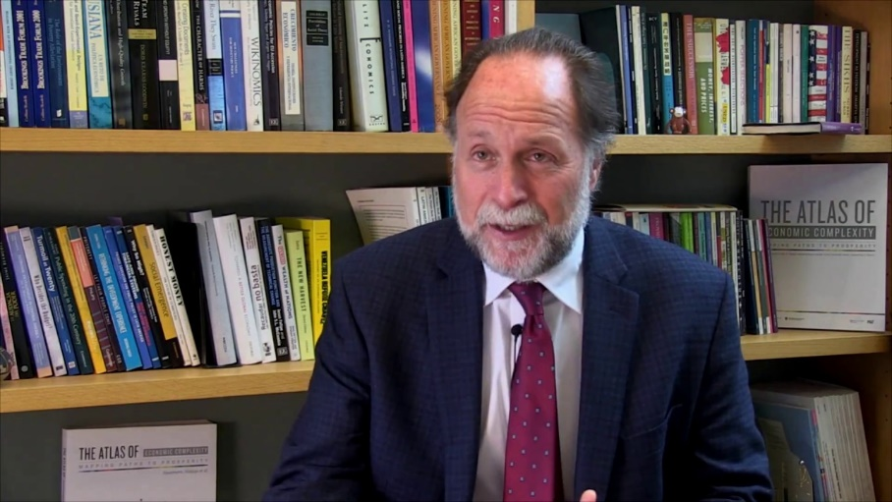

Founding parents

Slide 8
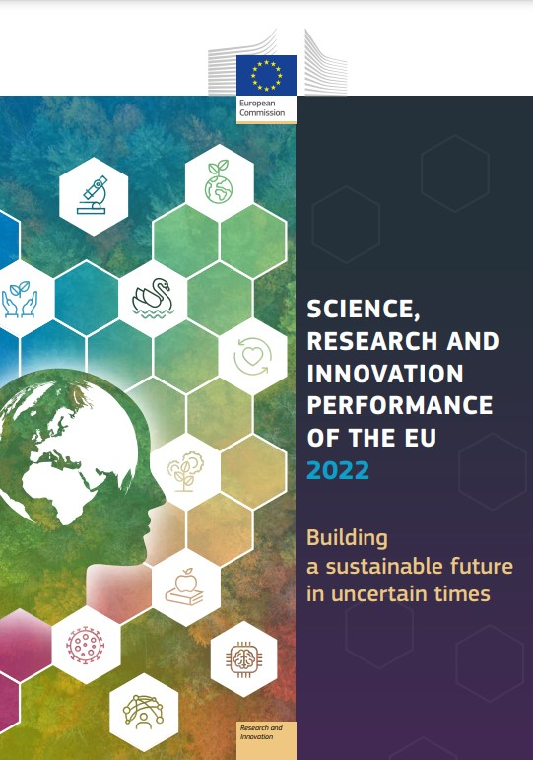
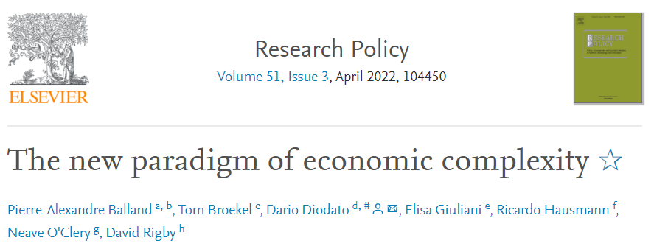

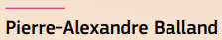

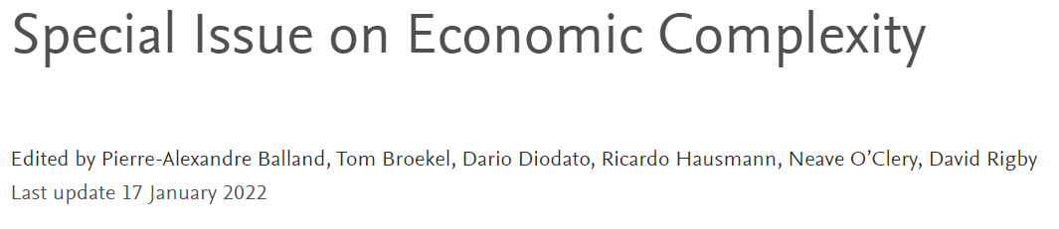
Recent reads

Slide 9
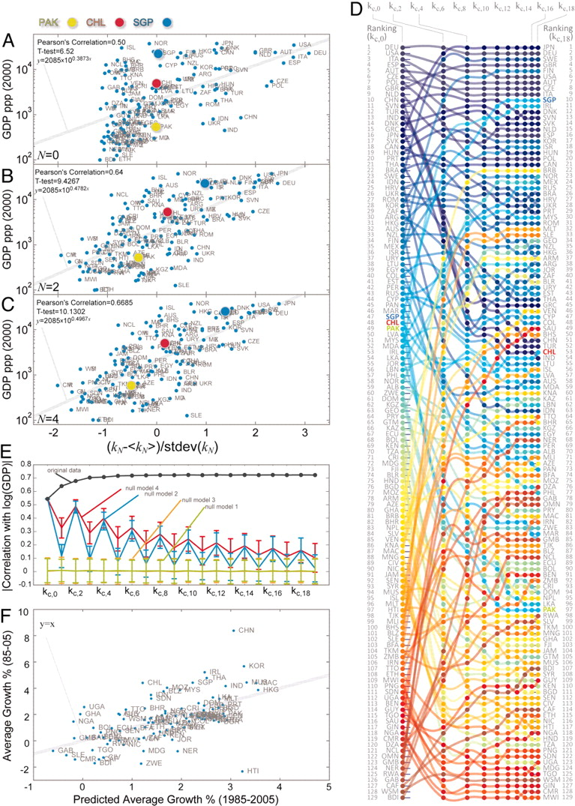
Complexity is a wealth generator
Economic complexity of a country/city is a strong predictor of its future growth
Adam Smith outlined the power of connections and the fact that they were hidden (‘invisible hand’)
Trade and division of labor are very efficient ways to organize the economy
New technologies and globalization allow for a deeper division of knowledge

Slide 10
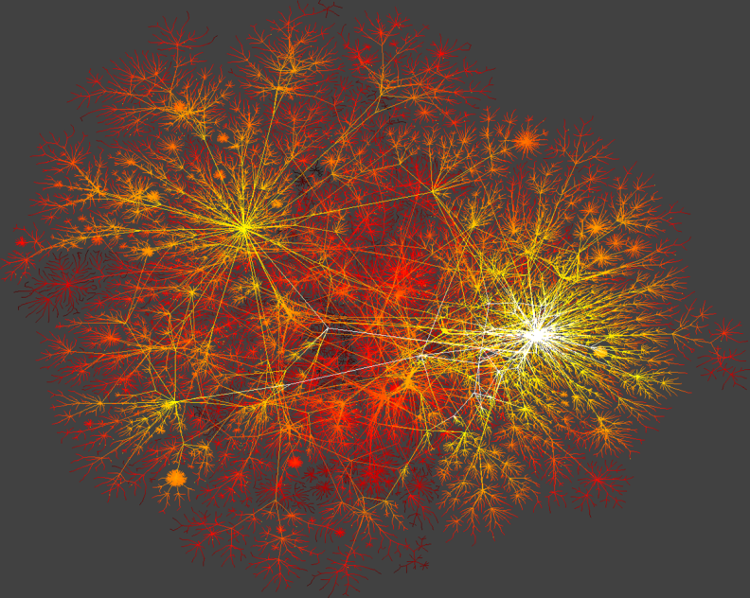
Complex systems are highly unequal
More complex societies are more unequal because large networks create extreme leverage

Slide 11
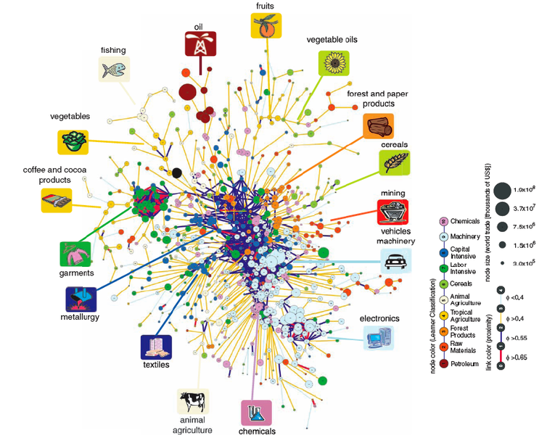
The product space

Slide 12
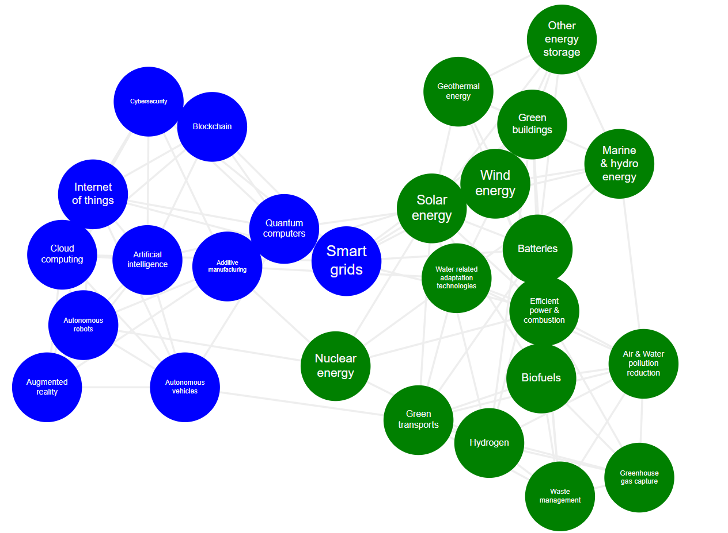
The technology space

Slide 13
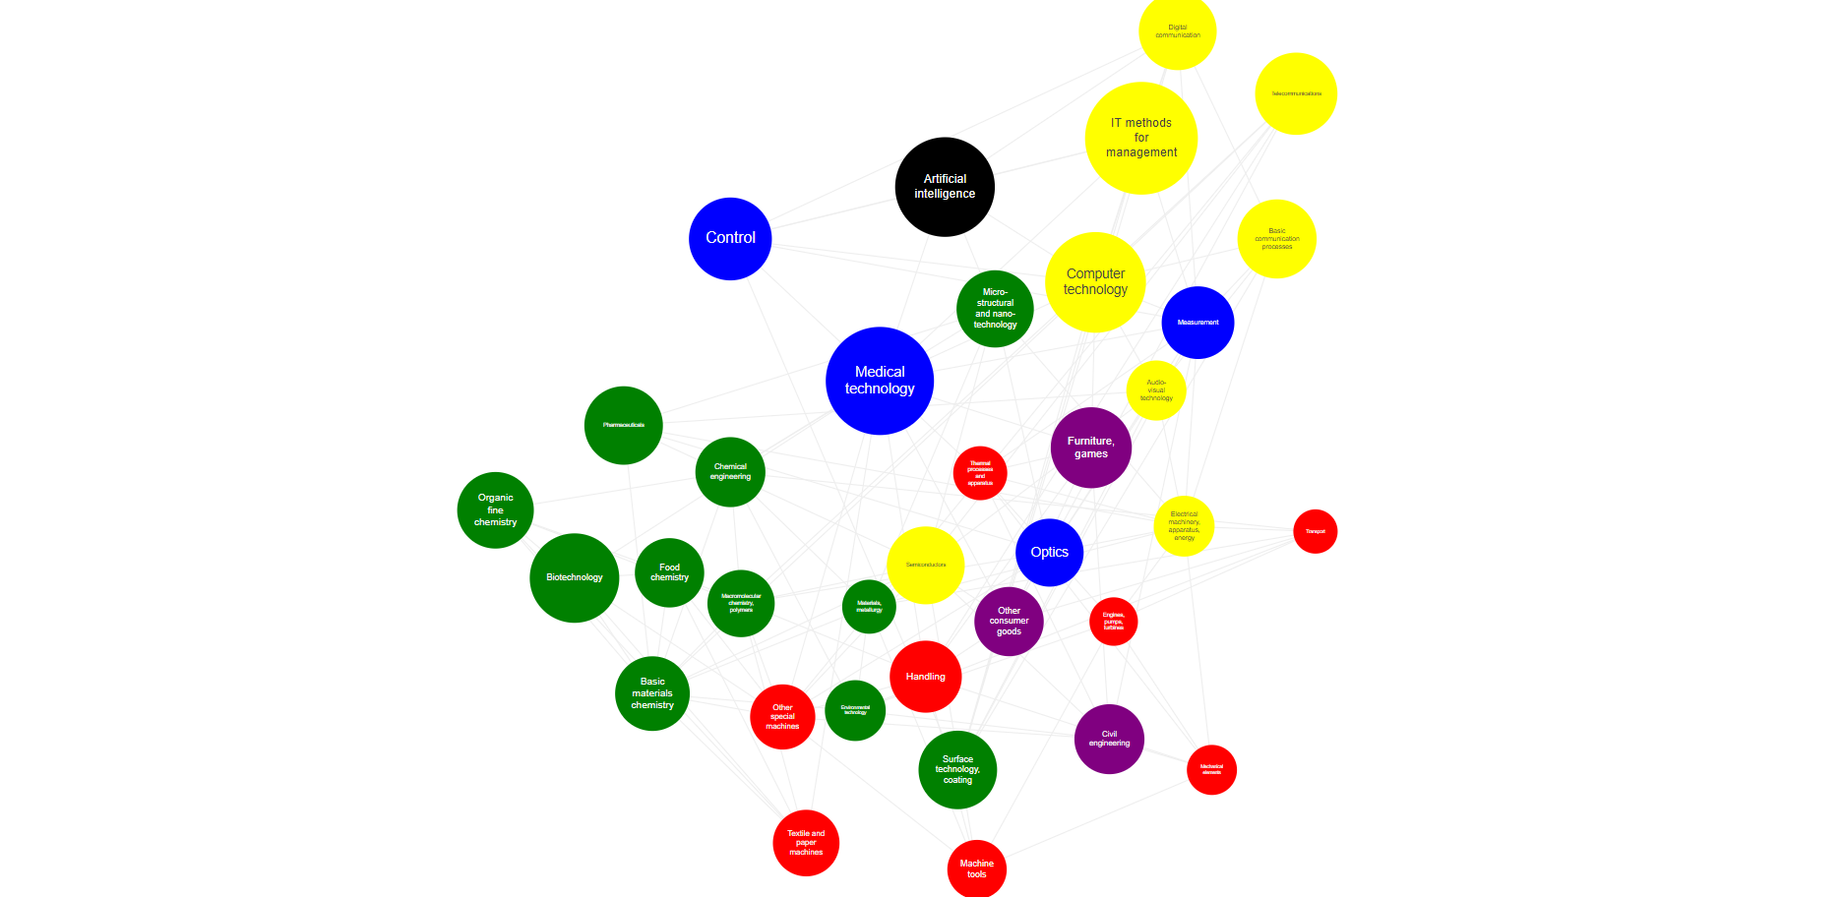
US knowledge space prior to the AI revolution
Balland, P.A. (2021)
Report for DG Grow

Slide 14
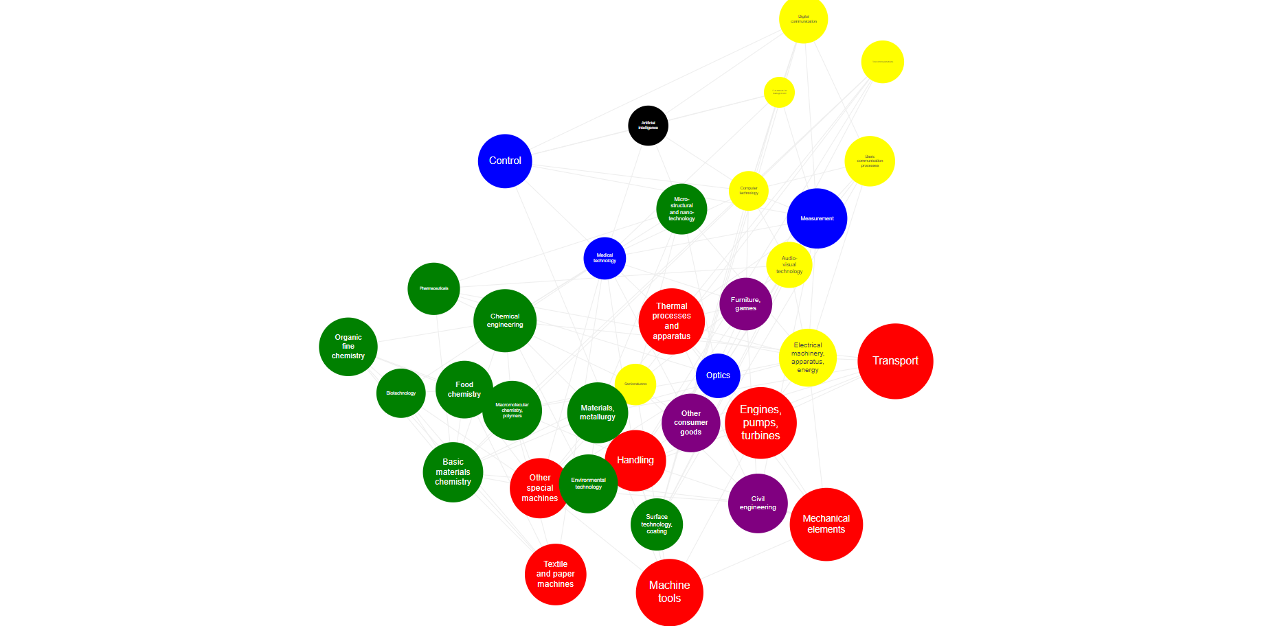
EU knowledge space prior to the AI revolution
Balland, P.A. (2021)
Report for DG Grow

Slide 15
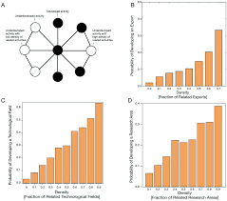
The principle of relatedness
The structure of the economy allows to predict its further evolution
Hidalgo, C., Balland, P.A., Boschma, R., Delgado, M., Feldman, M., Frenken, K., Glaeser, E., He, C., Kogler, D., Morrison, A., Neffke, F., Rigby, D., Stern, S., Zheng, S., and Zhu, S. (2018) The Principle of Relatedness, Unifying Themes in Complex Systems (IX): 451-457

Slide 16
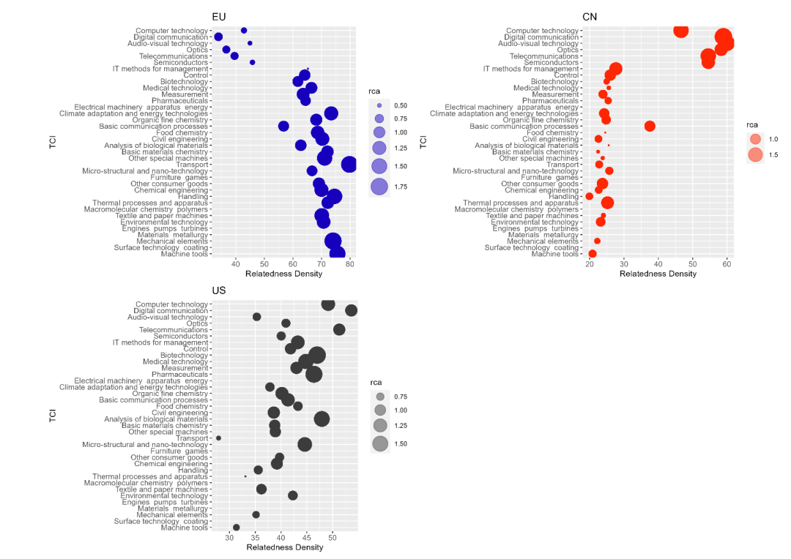
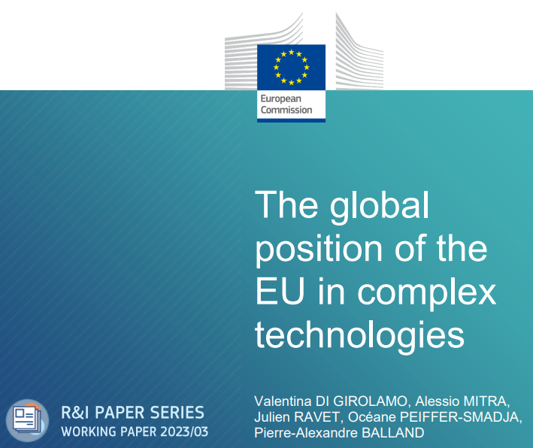

Slide 17
Smart Investment Framework
Complexity
High Risks
High Benefits
Low Risks
High Benefits
High Risks
Low Benefits
Low Risks
Low Benefits
Relatedness
Balland, P.A., Boschma, R., Crespo, J. and Rigby, D. (2019) Smart Specialization policy in the EU: Relatedness, Knowledge Complexity and Regional Diversification, Regional Studies, 53 (9): 1252-1268

Slide 18
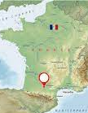
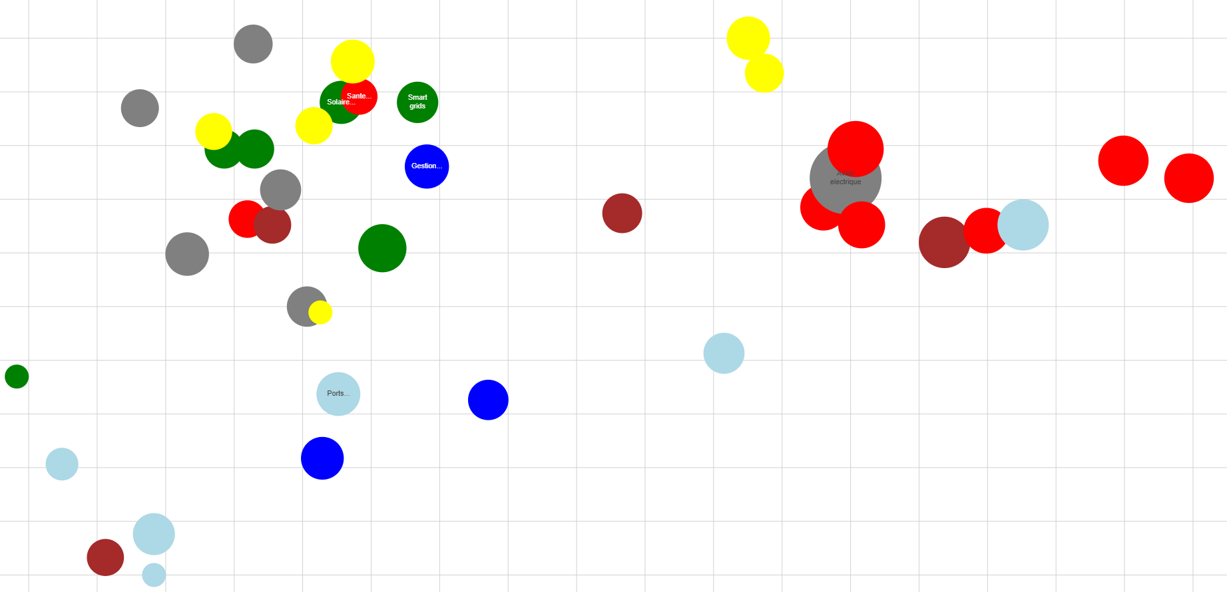

The case of the Toulouse region
Embedded Systems
Complexity
Batteries
Oncology
Smart grids
Composites materials
Electrical plane
Biotherapies
Protein of the future
Off-shore wind turbines
Geosciences
Relatedness

Slide 19
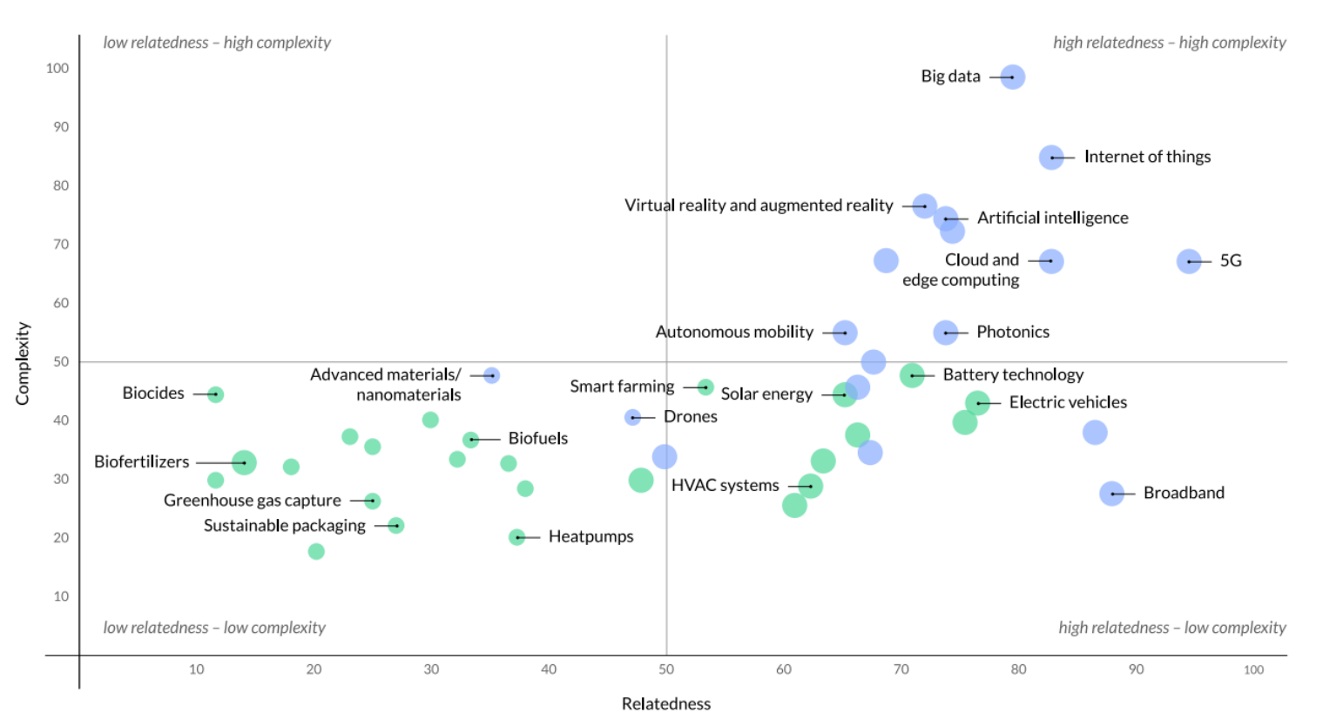

Slide 20
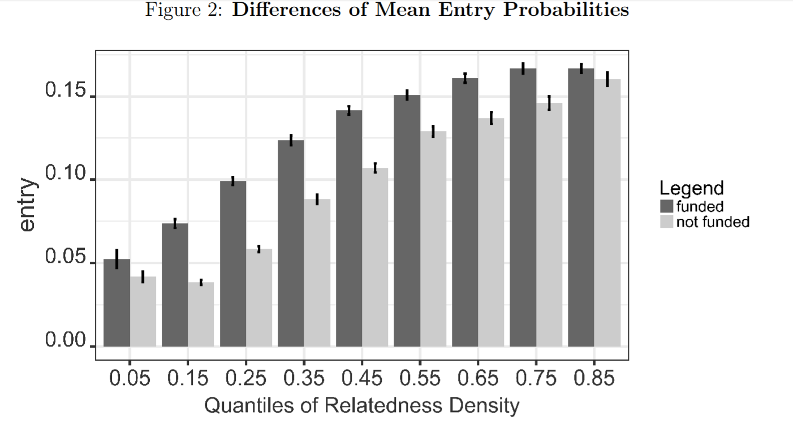
Uhlbach, W., Balland, P.A. & Scherngell, T. (2022); Industry and Innovation, 29 (4): 511-532.

Slide 21
Complex activities concentrate in large cities
Balland, P.A., Jara-Figueroa, C., Petralia, S., Steijn, M., Rigby, D., and Hidalgo, C. (2020) Complex Economic Activities Concentrate in Large Cities, Nature Human Behavior

Slide 22
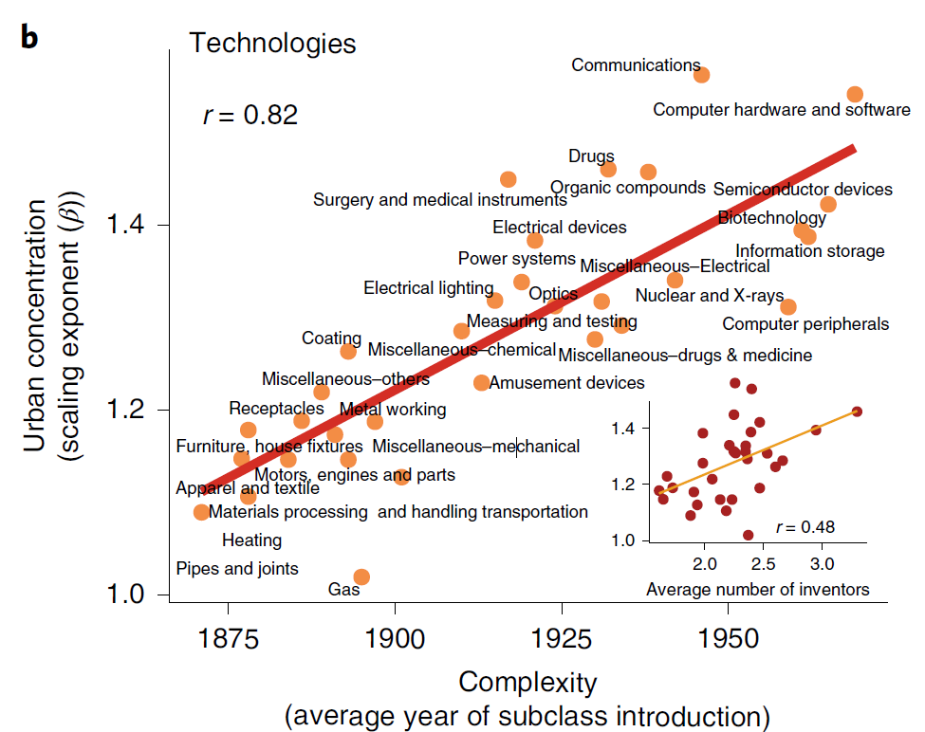
Complex activities concentrate in large cities

Slide 23
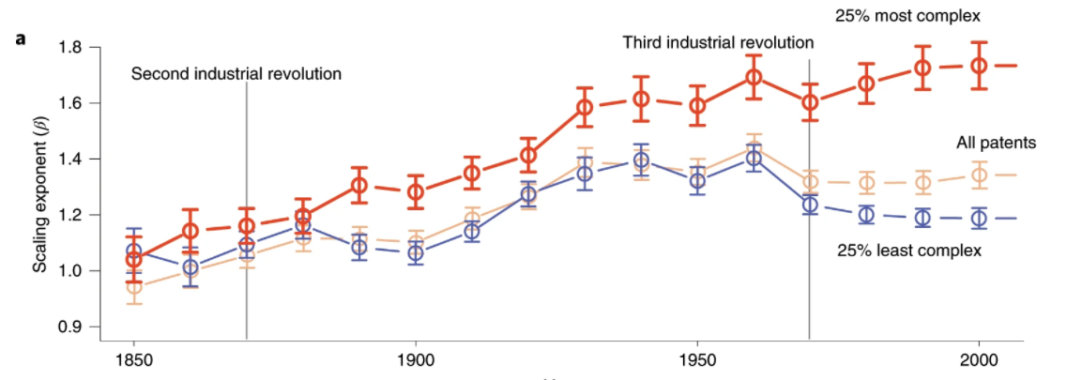
Complex activities concentrate in large cities
Balland, P.A., Jara-Figueroa, C., Petralia, S., Steijn, M., Rigby, D., and Hidalgo, C. (2020) Complex Economic Activities Concentrate in Large Cities, Nature Human Behavior

Slide 24
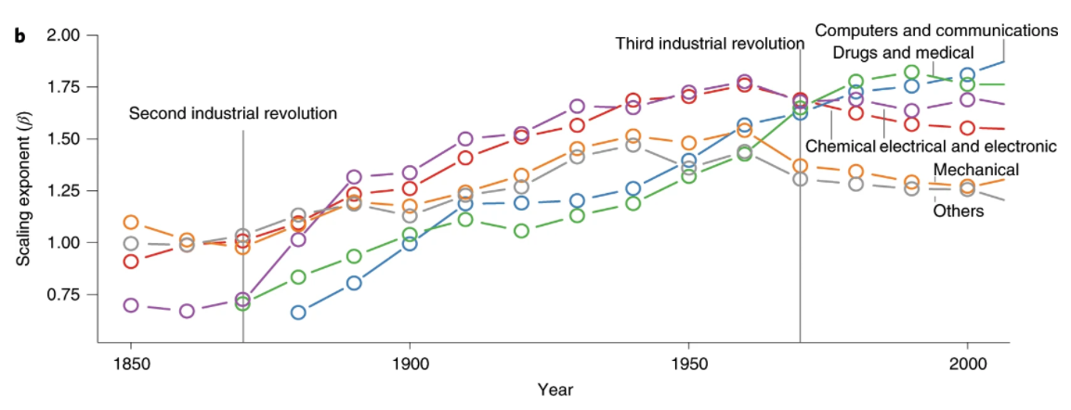
Complex activities concentrate in large cities
Balland, P.A., Jara-Figueroa, C., Petralia, S., Steijn, M., Rigby, D., and Hidalgo, C. (2020) Complex Economic Activities Concentrate in Large Cities, Nature Human Behavior

Slide 25
The World of Knowledge Consumption is Getting
Flatter
The World of Knowledge Production is Getting
Spikier
Digital technologies, transports and globalization allows products to be widely distributed (leveraged)
Knowledge increasingly concentrates as it becomes more complex
Winner Takes-All Economy
Notes:
products can be widely distributed (broad audience and network effects)
Rosen said that such breakthroughs as motion pictures, radio, and TV had greatly broadened the audiences—and hence the rewards—for those in show business and sports. Thirty years later, Brynjolfsson sees a similar effect for high-tech entrepreneurs, whose ideas and products can be widely distributed and produced thanks to software and other digital technologies. Why hire a local tax consultant when you can use a cheap, state-of-the-art program that is constantly being updated and refined? Likewise, why buy a second-best program or app? The ability to copy software and distribute digital products anywhere means customers will buy the top one. Why use a search engine that is almost as good as Google? Such economic logic now rules a growing share of the marketplace; it is, according to Brynjolfsson, an increasingly important reason why a few entrepreneurs, including the founders of such startups as Instagram, are growing rich at a staggering rate.

Slide 26
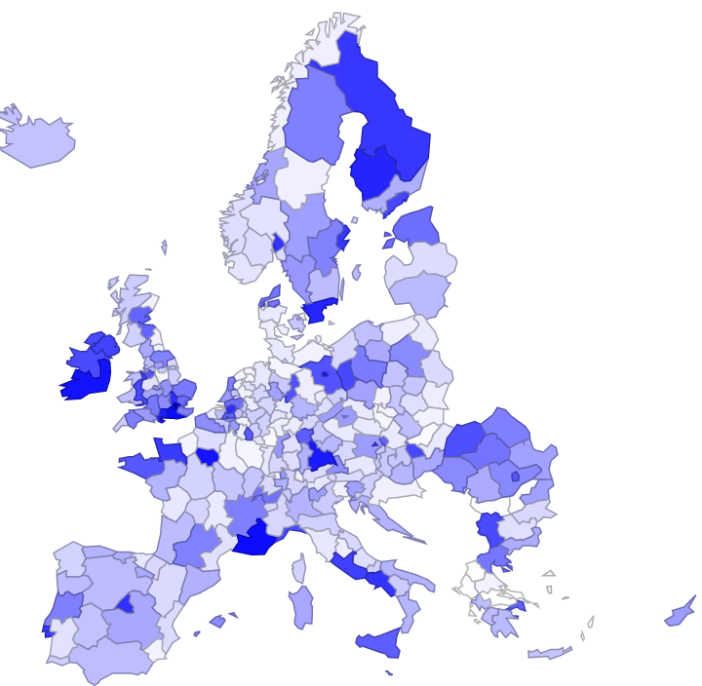
Where are blockchain hubs?
Balland, P.A (2022) – Chapter 14, SRIP report of the European Commission

Slide 27
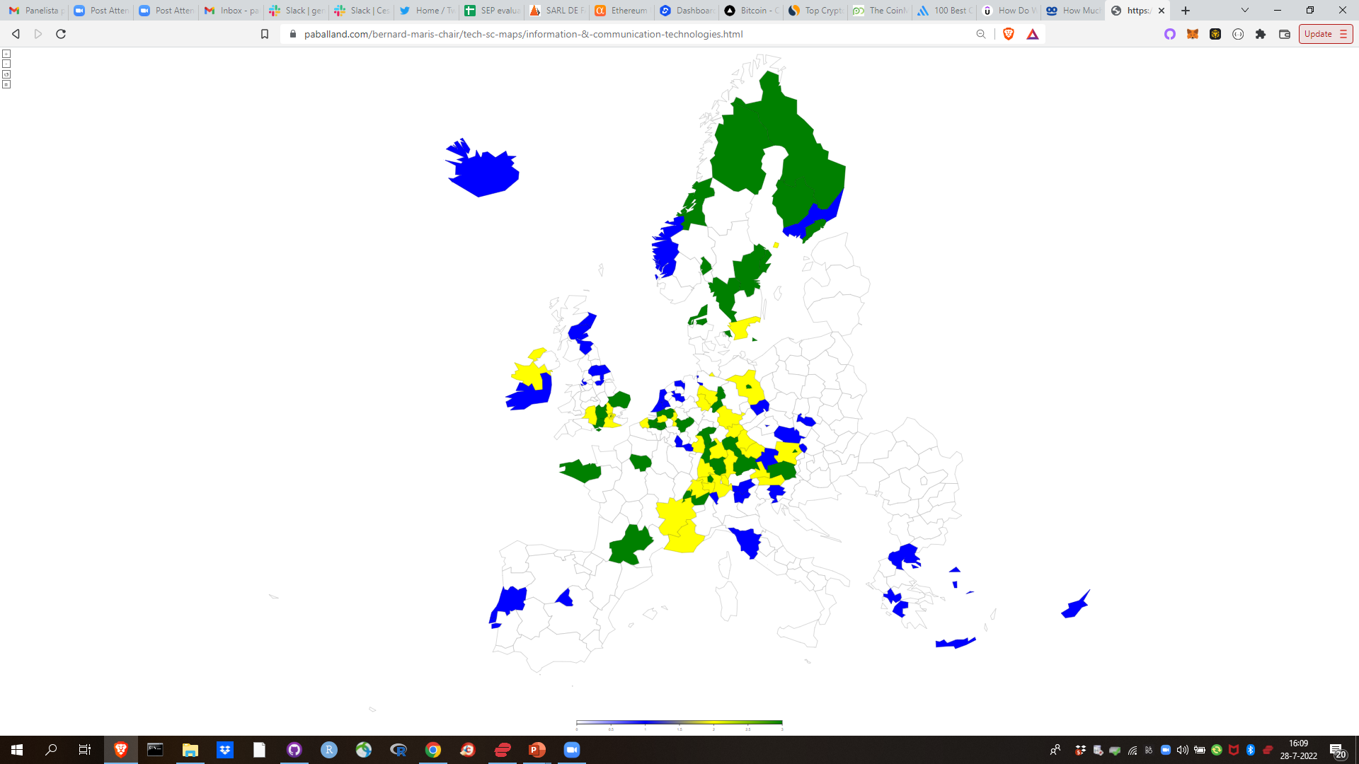
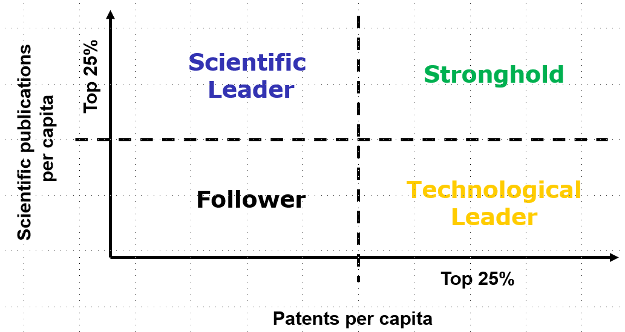

Adding the layer of scientific capabilities
Balland, P.A. & Boschma, R. (2022) Do scientific capabilities in specific domains matter for technological diversification in European regions?, Research Policy

Slide 28
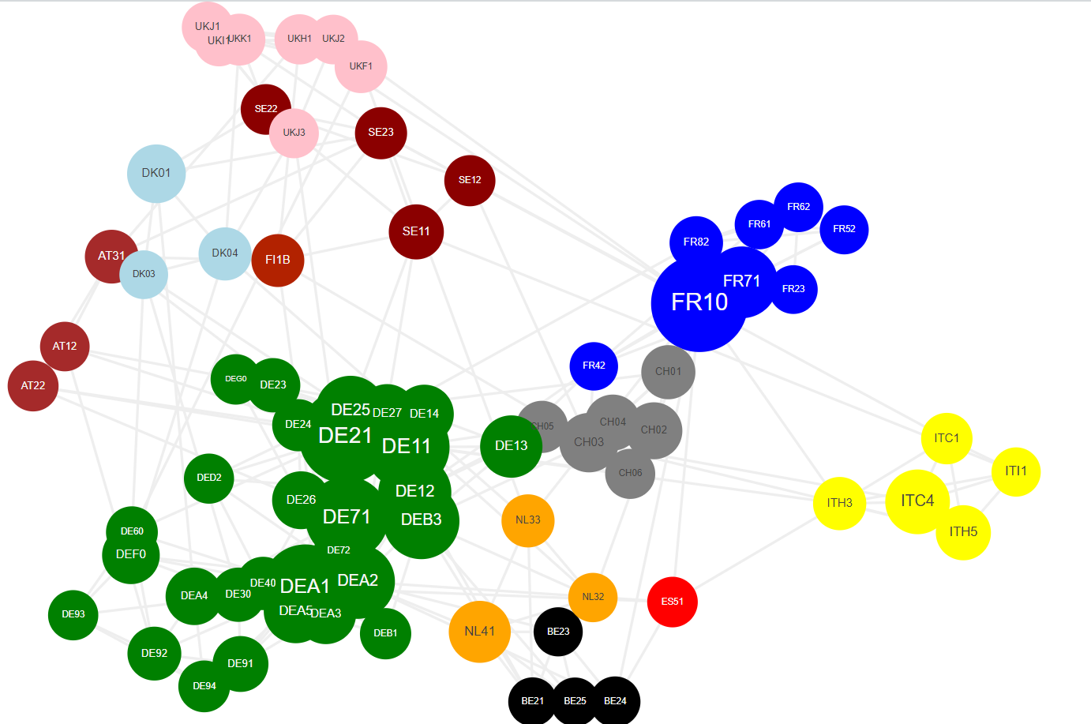
Co-inventorship
Balland, P.A (2022) – Chapter 14, SRIP report of the European Commission

Slide 29
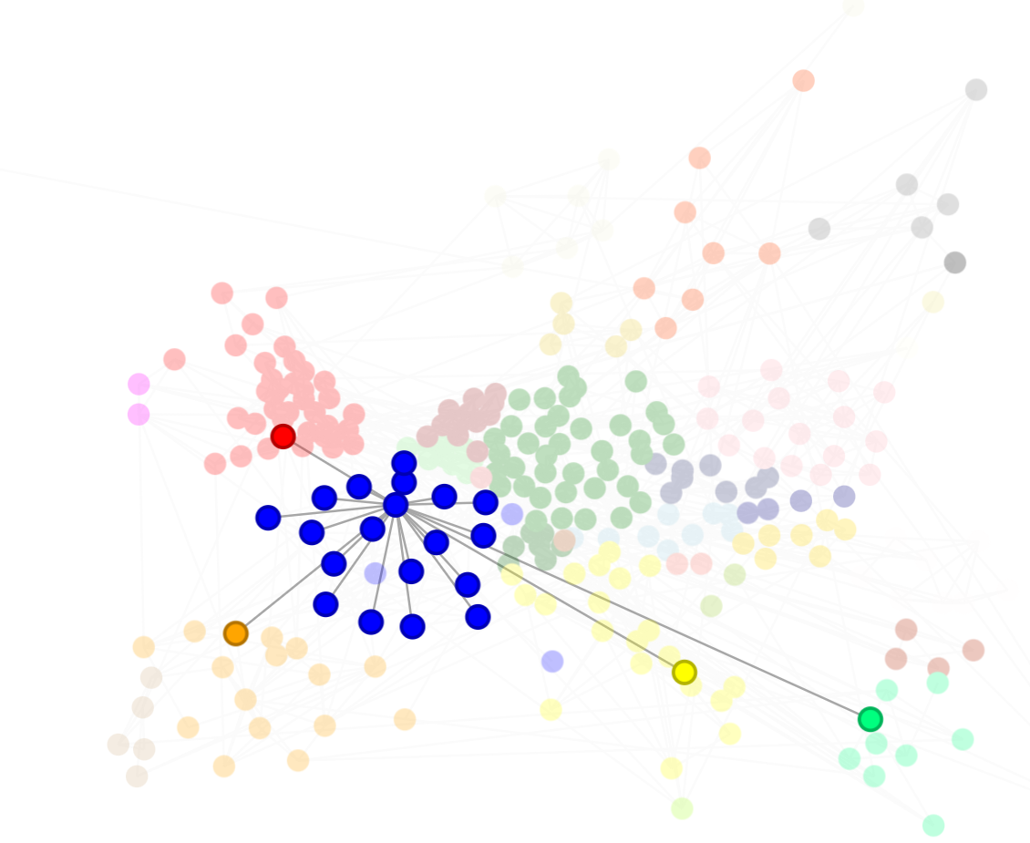
Co-inventorship
Bachtrögler-Unger, Balland, Boschma, Schwab (2023) – Bertelsmann Stiftung

Slide 30
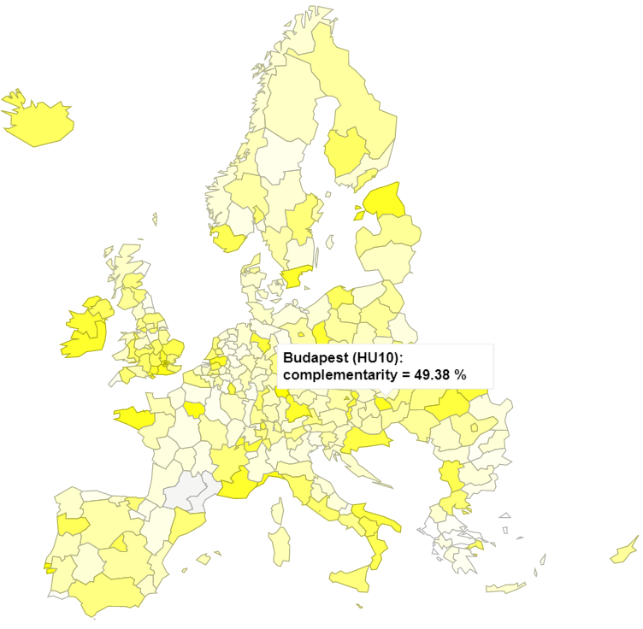
Connect with complementary regions
Complementarity levels in AI
Balland, P.A. and Boschma, R. (2021) Complementary Inter-Regional Linkages and Smart Specialization: an Empirical Study on European Regions, Regional Studies, 55 (6): 1059-1070.

Slide 31
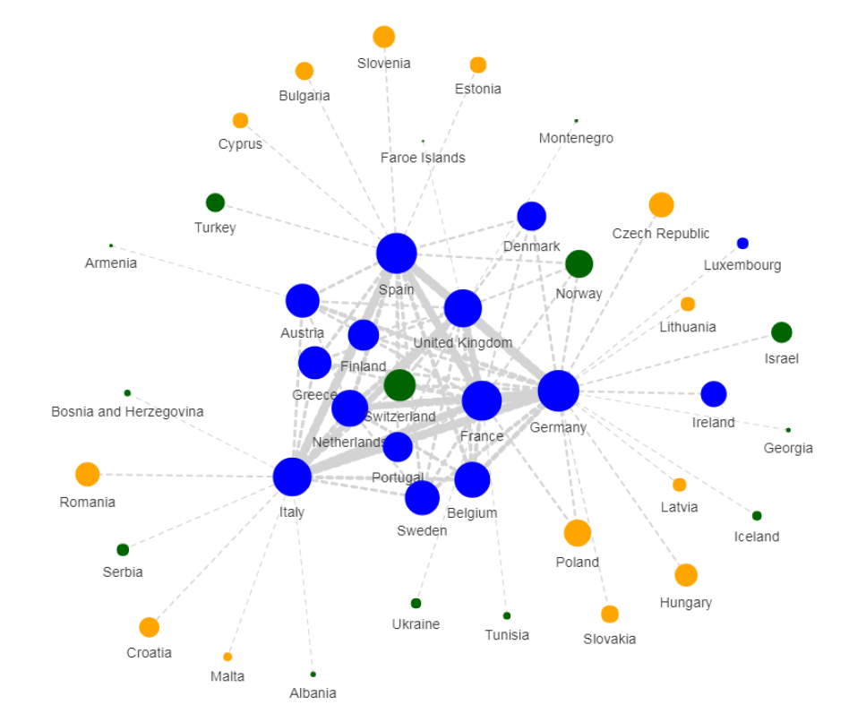
H2020 collaborations
Balland, P.A., Boschma, R., and Ravet, J. (2019) - European Planning Studies, 27 (9)

Slide 32
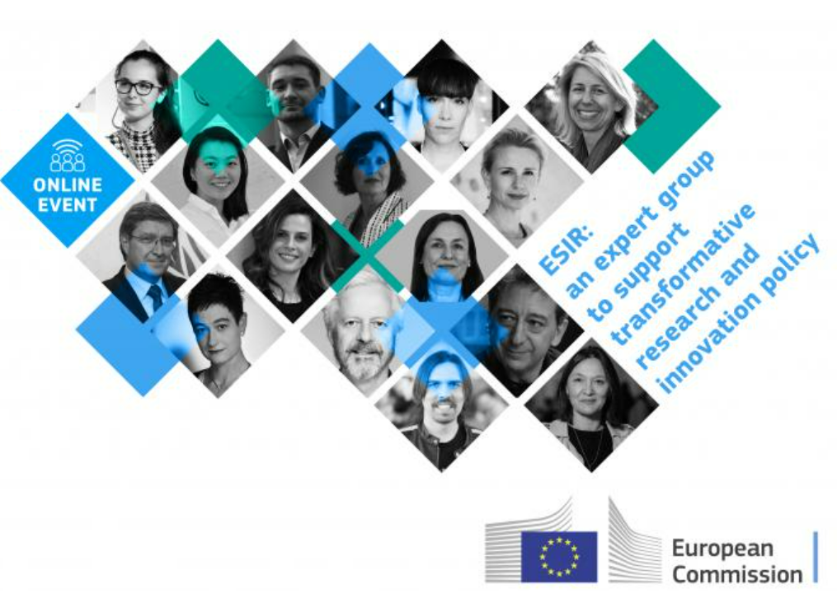
System thinking at ESIR
Industry 5.0, a transformative vision for Europe : governing systemic transformations towards a sustainable industry
Global value chains : harnessing innovation to protect and transform the backbone of global trade
Protect, prepare and transform Europe - Recovery and resilience post COVID-19
Unpacking tensions

Slide 33
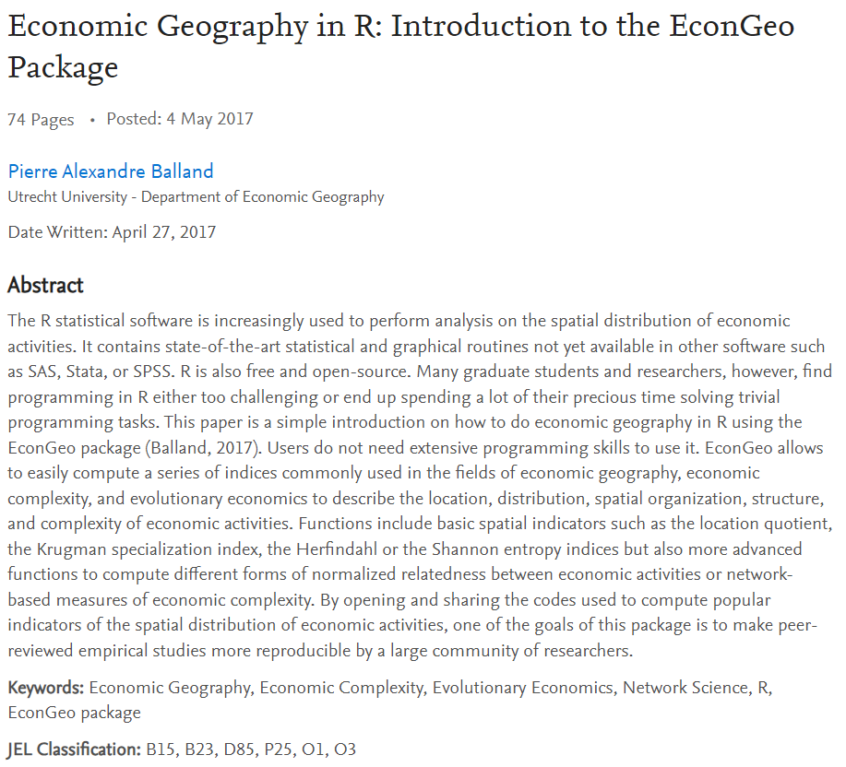
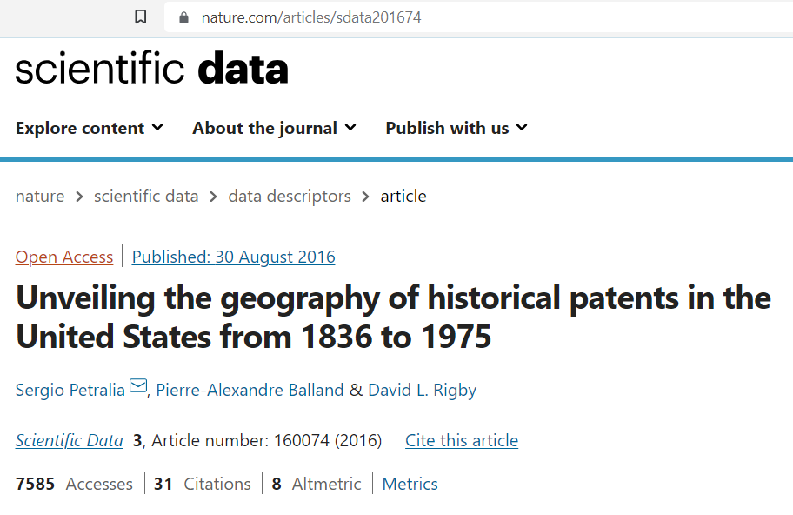
Software & open data

